Slide 1
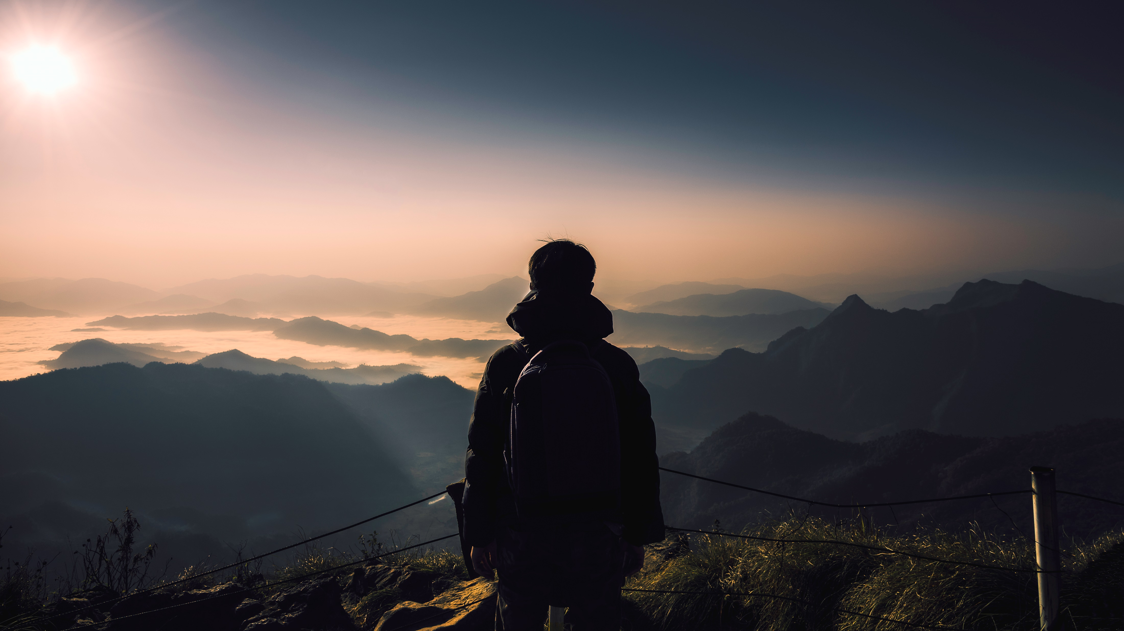
HOTEL Black & White

Slide 2



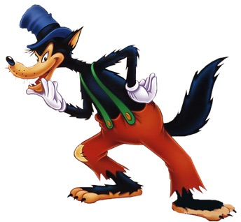
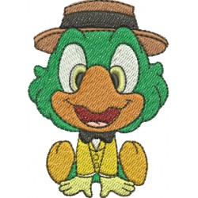
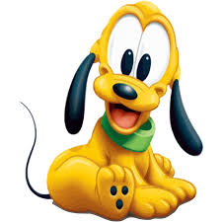

Team Retro
Wolfgang
Sandra
Barbara
Mattias

Slide 3
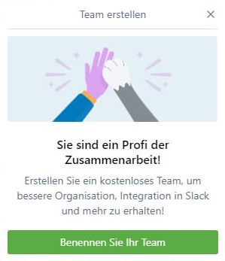

TEAM-Work
We decided everything together
Everyone was responsible for the success of our program
We found a place for everyone´s ideas
We worked together as a Team

Slide 4
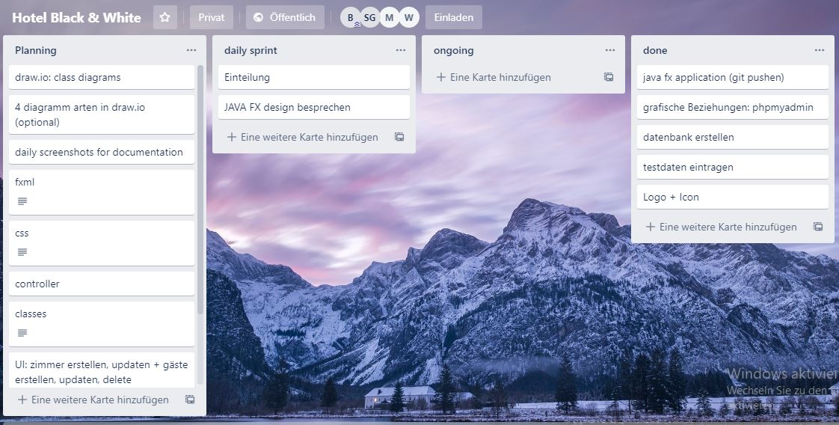
Trello – first week
planning the design
creating the program
create the database
team building

Slide 5
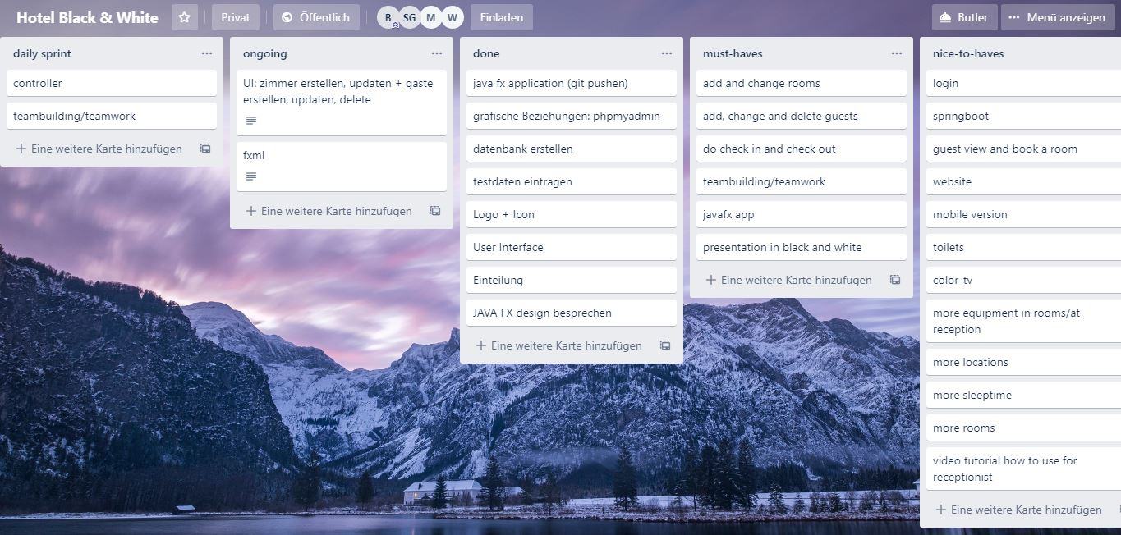
Trello – first half done
Design – already done
Programming
create a presentation
fix some issues
Database – already done

Slide 6
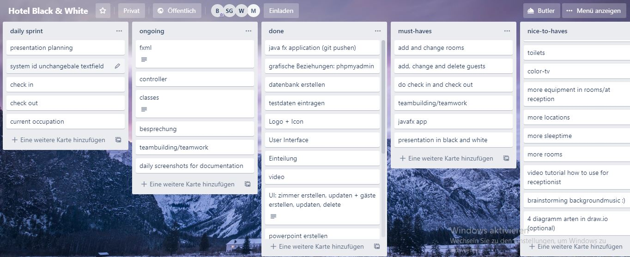
Trello – second week
programming
create a presentation
testing

Slide 7
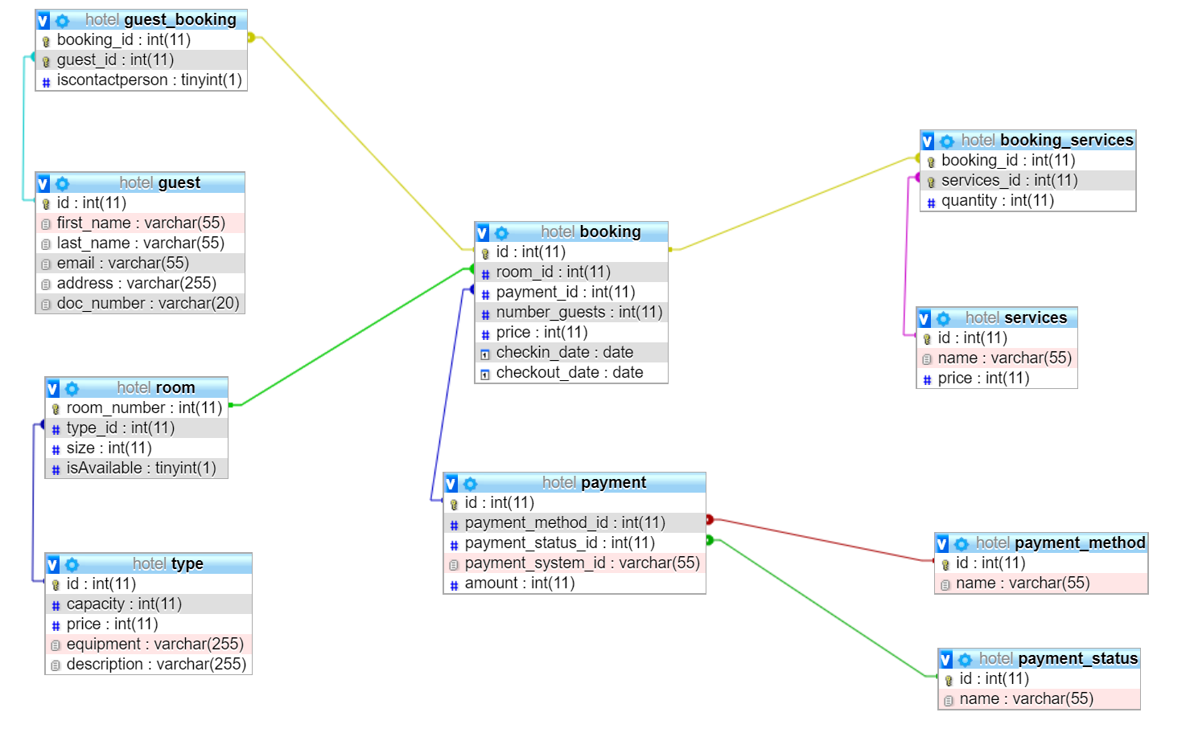

Slide 8
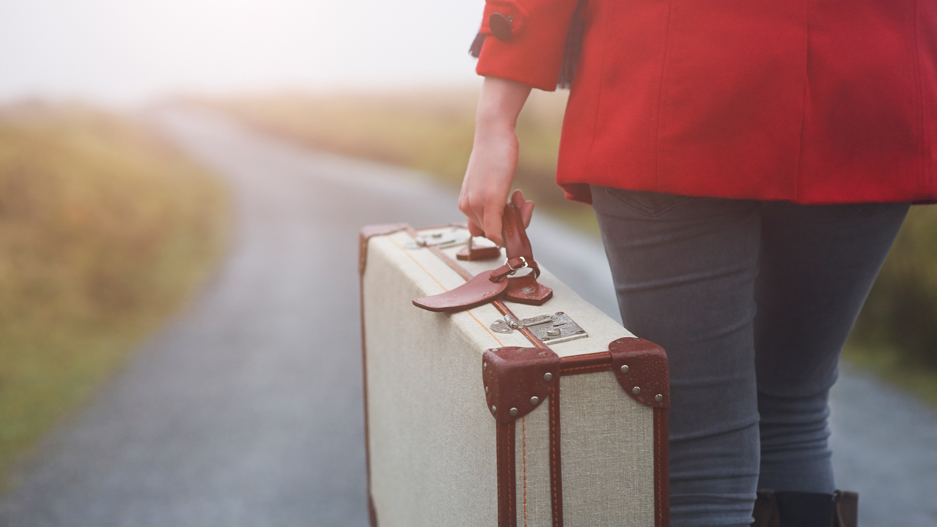
LET´S HAVE A LOOK

